Slide 1
Low Rank Approximation and Regression in Input Sparsity Time
David Woodruff
IBM Almaden
Joint work with Ken Clarkson (IBM Almaden)

Slide 2
Talk Outline
Least-Squares Regression
  Known Results
  Our Results
Low-Rank Approximation
  Known Results
  Our Results
Experiments

Slide 3
Least-Squares Regression
A is an n x d matrix, b an n x 1 column vector
Consider over-constrained case, n À d
Find x so that |Ax-b|₂ · (1+ε) min_{y} |Ay-b|₂
Allow a tiny probability of failure (depends only on randomness of algorithm, not on the input)

Slide 4
The Need for Approximation
For y = A⁻b, Ay is the “closest” point in the column space of A to the vector b
b
A
Computing y exactly takes O(nd²) time
Too slow, so we allow ε > 0 and a tiny probability of failure

Slide 5
Subspace Embeddings
Let k = O(d/ε²)
Let S be a k x n matrix of i.i.d. normal N(0,1/k) random variables
For any fixed d-dimensional subspace, i.e., the column space of an n x d matrix A
  W.h.p., for all x in R^{d}, |SAx|₂ = (1±ε)|Ax|₂
Entire column space of A is preserved
Why is this true?

Slide 6
Subspace Embeddings – A Proof
Want to show |SAx|₂ = (1±ε)|Ax|₂ for all x
Can assume columns of A are orthonormal (since we prove this for all x)
By rotational invariance, SA is a k x d matrix of i.i.d. N(0,1/k) random variables
Well-known that singular values of SA are all in the range [1-ε, 1+ε]
Hence, |SAx|₂ = (1±ε)|Ax|₂
What does this have to do with regression?

Slide 7
Subspace Embeddings for Regression
Want x so that |Ax-b|₂ · (1+ε) min_{y} |Ay-b|₂
Consider subspace L spanned by columns of A together with b
Then for all y in L, |Sy|₂ = (1± ε) |y|₂
Hence, |S(Ax-b)|₂ = (1± ε) |Ax-b|₂ for all x
Solve argmin_{y} |(SA)y – (Sb)|₂
Given SA, Sb, can solve in poly(d/ε) time
But computing SA takes O(nd²) time right?

Slide 8
Subspace Embeddings - Generalization
S need not be a matrix of i.i.d normals
Instead, a “Fast Johnson-Lindenstrauss matrix” S suffices
Usually have the form: S = P*H*D
  D is a diagonal matrix with +1, -1 on diagonals
  H is the Hadamard transform
  P just chooses a random (small) subset of rows of H*D
SA can be computed in O(nd log n) time

Slide 9
Previous Work vs. Our Result
[AM, DKM, DV, …, Sarlos, DMM, DMMW, KN]
Solve least-squares regression in
O(nd log d) + poly(d/ε) time
Our Result
  Solve least-squares regression in
  O(nnz(A)) + poly(d/ε) time,
  where nnz(A) is number of non-zero entries of A
  Much faster for sparse A, e.g., nnz(A) = O(n)

Slide 10
Our Technique
Better subspace embedding!
Define k x n matrix S, for k = poly(d/ε)
S is really sparse: single randomly chosen non-zero entry per column
[
[
0 0 1 0 0 1 0 0
1 0 0 0 0 0 0 0
0 0 0 -1 1 0 -1 0
0-1 0 0 0 0 0 1

Slide 11
Surprising Part
For certain k = poly(d/ε), w.h.p., for all x,
|SAx|₂ = (1 ± ε) |Ax|₂
Since S is so sparse, SA can be computed in nnz(A) time
Regression can be solved in nnz(A) + poly(d/ε) time

Slide 12
Why Did People Miss This?
Usually put a net on a d-dimensional subspace, and argue for all z in the net,
|SAz|₂ = (1 ± ε) |Az|₂
Since the net has size exp(d), need S to preserve the lengths of exp(d) vectors
If these vectors were arbitrary, the above S would not work!
So how could this possibly work?

Slide 13
Leverage Scores
Suffices to prove for all unit vectors x
|SAx|₂ = (1 ± ε) |Ax|₂
Can assume columns of A are orthonormal
  |A|_{F}² = d
Let T be any set of size d/¯ containing all i 2 [n] for which |A_{i}|₂² ¸ ¯
  T contains the large leverage scores
For any unit x in R^{d},
|(Ax)_{i}| = |<A_{i}, x>| · |A_{i}|₂ ¢ |x|₂ · |A_{i}|₂
Say a coordinate i is heavy if |(Ax)_{i}| ¸ ¯^{1/2}
  Heavy coordinates are a subset of T!

Slide 14
Perfect Hashing
View map S as randomly hashing coordinates into k buckets, and maintaining an inner product with a sign vector in each bucket
If k > 10d² /¯² = 10 |T|², then with constant probability, all coordinates in T are perfectly hashed
Call this event E and condition on E
[
[
0 0 1 0 0 1 0 0
1 0 0 0 0 0 0 0
0 0 0 -1 1 0 -1 0
0-1 0 0 0 0 0 1

Slide 15
The Three Error Terms
Suppose y = Ax for an x in R^{d}
y = y_{T} + y_{[n] \ T}
|Sy|₂² = |Sy_{T}|₂² + |Sy_{[n]\T}|₂² + 2<Sy_{T}, Sy_{[n]\T}>

Slide 16
The Large Coordinate Error Term
Need to bound |Sy_{T}|₂²
Since event E occurs, |Sy_{T}|₂² = |y_{T}|₂²

Slide 17
The Small Coordinate Error Term
Need to bound |Sy_{[n]\T} |₂²
Key point: |y_{[n]\T}|₁ is small
[DKS]: There is an ® ¼ ε²/d so that if k = Ω(log(1/δ)/ε²) for a mapping of our form S, then for any vector y with |y|₁ = O(®),
Pr[|Sy|₂² = |y|₂² ± O(ε)] = 1 – O(δ)
Set ¯ = O(®²) = 1/poly(d/ε) so |y_{[n]\T}|₁ = O(®)
Hence, Pr[|Sy_{[n]\T}|₂² = |y_{[n]/T}|₂² ± O(ε) ] = 1 – O(δ)

Slide 18
The Cross-Coordinate Error Term
Need to bound |<Sy_{T}, Sy_{[n]\T}>|
Sy_{T} only has support on |T| coordinates
Let G µ [n]\T be such that each i 2 G hashes to a bucket containing a j 2 T
|<Sy_{T}, Sy_{[n]\T}>| = |<Sy_{T}, Sy_{G}>| · |Sy_{T}|₂¢|Sy_{G}|₂
|Sy_{T}|₂ = |y_{T}|₂ · 1 by event E
Pr[|Sy_{G}|₂ · |y_{G}|₂ + O(ε)] = 1-O(δ) by [DKS]
Pr[|y_{G}|₂ · ε] = 1-O(δ) by Hoeffding
Hence, Pr[|<Sy_{T}, Sy_{[n]\T}>| · 2ε] = 1- O(δ)

Slide 19
Putting it All Together
Given that event E occurs, for any fixed y, with probability at least 1-O(δ):
|Sy|₂² = |Sy_{T}|₂² + |Sy_{[n]\T}|₂² + 2<Sy_{T}, Sy_{[n]\T}>
= |y_{T}|₂² + |y_{[n]\T}|₂² ± O(ε)
= |y|₂² ± O(ε)
= (1 ± O(ε))|y|₂²

Slide 20
The Net Argument
[F, M, AHK]: If for any fixed pair of unit vectors x,y, a random d x d matrix M satisfies
Pr[|x^{T} M y| = O(ε)] > 1-exp(-d),
then for every unit vector x, |x^{T}Mx| = O(ε)
We apply this to M = (SA)^{T} SA-I_{d}
Set δ = exp(-d):
  For any x,y with probability 1-exp(-d):
  |SA(x+y)|₂ = (1±ε)|A(x+y)|₂
|SAx|₂ = (1±ε)|Ax|₂ ,
|SAy|₂ = (1±ε)|Ay|₂
Hence, |x^{T} M y| = O(ε)

Slide 21
Talk Outline
Least-Squares Regression
  Known Results
  Our Results
Low-Rank Approximation
  Known Results
  Our Results
Experiments

Slide 22
Low Rank Approximation
A is an n x n matrix
Want to output a rank k matrix A’, so that
|A-A’|_{F} · (1+ε) |A-A_{k}|_{F},
w.h.p., where A_{k} = argmin_{rank k matrices B} |A-B|_{F}
Previous results:
nnz(A)*(k/ε + k log k) + n*poly(k/ε)
Our result: nnz(A) + n*poly(k/ε)

Slide 23
Technique
[CW] Let S be an n x k/ε² matrix of i.i.d. ±1 entries, and R an n x k/ε matrix of i.i.d. ±1 entries. Let A’ = AR(S^{T}AR)⁻ S^{T}A.
Can extract low rank approximation from A’
Our result: similar analysis works if R, S are our new subspace embedding matrices
Operations take nnz(A) + n*poly(k/ε) time

Slide 24
Talk Outline
Least-Squares Regression
  Known Results
  Our Results
Low-Rank Approximation
  Known Results
  Our Results
Experiments

Slide 25
Experiments
Looked at low rank approximation
  n ¼ 600, nnz(A) at most 10⁵
Test matrices from University of Florida Sparse Matrix Collection
40 different sparsity patterns, representing different application areas
500 different matrices
Dominant time is computing SA, takes same time as one matrix-vector product in Lanczos

Slide 26
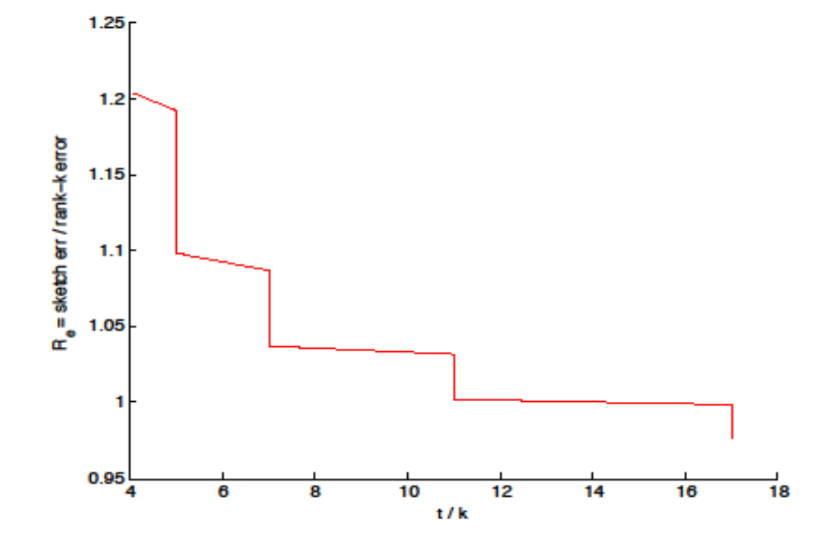
Experiments

Slide 27
Conclusions
Gave new subspace embedding of a d-dimensional subspace of R^{n} in time:
nnz(A) + poly(d/ε)
Achieved the same time for regression, improving prior nd log d time algorithms
Achieved nnz(A) + n*poly(k/ε) time for low-rank approximation, improving previous nd log d + n*poly(k/ε) time algorithms

